Slide 1
Web 3.0 - Powered Gaming: Our Vision

Slide 2

Welcome to the pitch deck for our gaming studio, which is at the forefront of embracing Web 3.0 technologies.
In this presentation, we will compare Web 3.0 with Web 2.0
We believe that Web 3.0 represents the future of gaming, offering unprecedented opportunities for innovation, player engagement, and monetization.
Let's dive in and explore the exciting world of Web 3.0 gaming!

Slide 3
Table of contents
01
02
03
04
05
06
Introduction
Market Analysis- Web 2.0 Gaming
Market Analysis- Web 3.0 Gaming
Competitive Analysis Web 2.0 Gaming
Competitive Analysis Web 3.0 Gaming
Findings and Conclusions

Slide 4
Introduction

Slide 5
The evolution of the internet has been defined by distinct eras, each revolutionizing the way we interact with information and each other. Web 3.0 marks the next paradigm shift, a transformative phase that fundamentally changes how we perceive, engage, and transact online.
Web 2.0, the current phase, introduced social media, user-generated content, and interactive web experiences. However, it relied heavily on centralized platforms, where user data and control predominantly resided in the hands of a few corporations. In contrast, Web 3.0 heralds a decentralized internet, offering a more democratized and user-centric ecosystem

Slide 6
Web 2.0 Vs Web 3.0
Features | Web 2.0 | Web 3.0
Decentralization | Centralized architecture with control in the hands of corporations and service providers. | Decentralized architecture with control distributed among users and peer-to-peer networks.
Data Ownership | User data owned and controlled by corporations, leading to privacy concerns. | User data owned and controlled by individuals, giving them more control over their privacy.
Interoperability | Limited interoperability between platforms and services. | Enhanced interoperability between platforms and services, allowing for seamless data sharing and collaboration.
Smart Contracts | Not supported. | Support for smart contracts, enabling programmable and self-executing agreements.

Slide 7
Web 2.0 Vs Web 3.0
Features | Web 2.0 | Web 3.0
Blockchain Technology | Not utilized. | Utilizes blockchain technology for transparency, security, and trust in transactions and data management.
Virtual Reality (VR) | Limited integration with VR technologies. | Enhanced integration with VR technologies, enabling immersive and interactive experiences.
Artificial Intelligence (AI) | Limited integration with AI technologies. | Enhanced integration with AI technologies, enabling intelligent automation and personalized experiences.

Slide 8
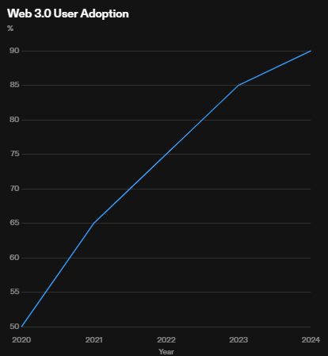
Features
Decentralization: Web 3.0 is built on decentralized networks, allowing for greater transparency, security, and control for gamers.
Smart Contracts: Web 3.0 utilizes smart contracts to enable trustless transactions and automate in-game processes, enhancing efficiency and reducing fraud.
Tokenization: Web 3.0 introduces the use of tokens, allowing for the creation of unique in-game assets, digital currencies, and provable scarcity.
Interoperability: Web 3.0 enables seamless interaction between different gaming platforms and ecosystems, promoting cross-game experiences and economies.
Community Governance: Web 3.0 empowers gamers by giving them a voice in the decision-making process through decentralized governance models.

Slide 9
Market Analysis- Web 2.0 Gaming

Slide 10
Overview
The gaming market in the Web 2.0 realm has experienced significant growth over the past decade. With advancements in technology and the increasing popularity of online gaming, the market has become more accessible and diverse.
Demographics
Web 2.0 gaming appeals to a wide range of demographics, including both casual and hardcore gamers. The accessibility of online gaming platforms has attracted players of all ages, genders, and backgrounds.
Popular Genres
Web 2.0 gaming offers a diverse range of genres to cater to different player preferences. Some of the most popular genres in the market include:
Action/Adventure
Role-Playing Games (RPGs)
First-Person Shooters (FPS)
Strategy Games

Slide 11
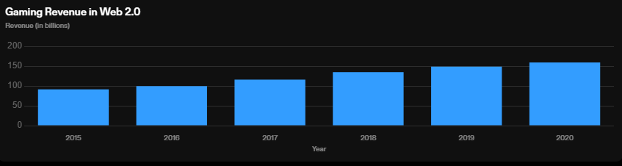
Insights
The gaming market in Web 2.0 has experienced consistent growth in revenue over the years.
Revenue increased from $91.5 billion in 2015 to $159.3 billion in 2020.

Slide 12
Market Analysis- Web 3.0 Gaming

Slide 13
Overview
With the emergence of Web 3.0 technologies, the gaming market has undergone a significant transformation. Web 3.0, also known as the decentralized web, enables gamers to have true ownership of their in-game assets and the ability to trade them freely.
Benefits of Web 3.0 Gaming
True Ownership: Players have full control and ownership of their in-game assets, which can be traded or sold on decentralized marketplaces.
Interoperability: Web 3.0 allows for seamless integration of different games and platforms, enabling cross-game interactions and collaborations.
Transparency: The use of blockchain technology ensures transparency in transactions and prevents fraud or manipulation of in-game assets.
Market Growth and Opportunities
The gaming market in Web 3.0 is experiencing rapid growth, driven by the increasing popularity of blockchain-based games and the demand for decentralized gaming experiences. This presents numerous opportunities for gaming studios to innovate and create unique gaming experiences that leverage the benefits of Web 3.0 technologies.

Slide 14
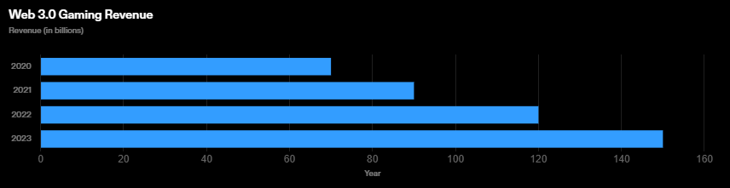
Insights
The market potential of Web 3.0 gaming is rapidly growing, with revenue projected to reach $150 billion by 2023.
Web 3.0 technologies, such as blockchain and decentralized finance (DeFi), are revolutionizing the gaming industry by enabling true ownership of in-game assets and creating new revenue streams.
The rise of play-to-earn models and non-fungible tokens (NFTs) in Web 3.0 gaming is attracting a larger audience and driving user engagement.

Slide 15
Competitive Analysis- Web 2.0 Gaming

Slide 16

In the realm of Web 2.0 gaming, several major gaming studios have established themselves as dominant forces. Here's a breakdown of a few key players and their strengths and weaknesses:
1. Activision Blizzard
Strengths:
Franchise Powerhouses: Owns some of the most popular gaming franchises like Call of Duty, World of Warcraft, and Overwatch, ensuring a consistent player base.
Strong Development Teams: Known for high-quality game development and storytelling.
E-sports Presence: Invested in e-sports leagues like Overwatch League and Call of Duty League, fostering competitive gaming communities.
Weaknesses:
Controversies: Faced criticism over workplace culture and issues related to diversity and inclusion.
Heavy Dependence on Franchises: Reliance on existing franchises might limit innovation and risk-taking in new game development.

Slide 17

2. Electronic Arts (EA)
Strengths:
Sports Franchises: Dominates sports gaming with titles like FIFA, Madden NFL, and NBA Live.
Strong IPs: Owns popular IPs such as Battlefield and The Sims, ensuring a diverse portfolio.
Acquisition Strategy: Acquires successful studios like Respawn Entertainment (creators of Apex Legends) to expand their game offerings.
Weaknesses:
Monetization Concerns: Infamous for microtransactions and monetization strategies that face backlash from players.
Creativity Challenges: Criticized for a lack of innovation in some of their game franchises.

Slide 18
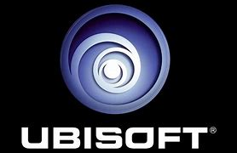
3. Ubisoft
Strengths:
Diverse Game Portfolio: Offers a wide range of gaming experiences, from Assassin's Creed to Just Dance, appealing to different player preferences.
Open-World Expertise: Known for crafting detailed and immersive open-world games.
Global Studios: Has a global network of development studios contributing to game development.
Weaknesses:
Repetitive Formulas: Some criticism for repetition and similarities in game mechanics across franchises.
Quality Control Issues: Past games have faced technical issues and bugs at launch, impacting player experiences.

Slide 19
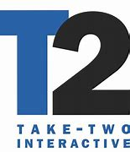
4. Take-Two Interactive
Strengths:
Rockstar Games: Owns Rockstar Games, responsible for the Grand Theft Auto and Red Dead Redemption series, known for high-quality and immensely popular titles.
2K Games: Publishes successful sports titles like NBA 2K and WWE 2K.
Weaknesses:
Dependency on Key Franchises: Heavy reliance on blockbuster franchises could limit diversity in their gaming portfolio.
Development Timelines: Long gaps between major releases, leading to prolonged waits for new content.

Slide 20
Competitive Analysis- Web 3.0 Gaming

Slide 21
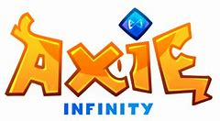

Axie Infinity
Strengths: Pioneered the play-to-earn model, creating an economy around breeding, battling, and trading NFT-based creatures. Strong community engagement and a thriving secondary marketplace for in-game assets.
Weaknesses: Scalability concerns due to high gas fees on Ethereum. Faces challenges in onboarding new users unfamiliar with crypto.
The Sandbox
Strengths: Building a decentralized gaming metaverse where users can create, own, and monetize voxel assets using NFTs. Emphasizes user-generated content and virtual land ownership.
Weaknesses: Development and scalability challenges in creating a seamless, interactive metaverse experience.

Slide 22


Decentraland
Strengths: One of the earliest blockchain-based virtual worlds allowing users to buy, sell, and develop virtual real estate. Strong focus on user ownership and community-driven governance.
Weaknesses: Limited mainstream adoption due to the learning curve associated with crypto and limited content diversity.
Enjin
Strengths: Building a gaming ecosystem with blockchain-based assets and tools for developers. Offers SDKs, gaming wallets, and a marketplace for NFTs, aiming to facilitate mainstream adoption.
Weaknesses: Faces competition in attracting developers to utilize their platform over others offering similar services.

Slide 23
Research Findings

Slide 24
Finding | Description
Decentralization | Web 3.0 gaming platforms leverage blockchain technology to enable decentralized ownership and control of in-game assets, providing players with true ownership and the ability to trade or sell assets.
Interoperability | Web 3.0 gaming allows for interoperability between different games and platforms, enabling seamless transfer of assets and data across multiple games and ecosystems.
Play-to-Earn | Web 3.0 gaming introduces the concept of play-to-earn, where players can earn real-world value by participating in and contributing to the game ecosystem, creating new opportunities for income generation.
Community Governance | Web 3.0 gaming platforms often adopt community governance models, where decisions regarding game development, updates, and governance are made collectively by the community, fostering a sense of ownership and inclusivity.
Scalability | Scalability remains a challenge for Web 3.0 gaming, as current blockchain infrastructure may not be able to handle the high transaction volumes and real-time gameplay requirements of popular games. However, advancements in blockchain technology are being made to address these scalability issues.

Slide 25
Unique Selling Points
Cutting-Edge Technology
Immersive Gameplay
Play-to-Earn Economy
Our gaming studio is at the forefront of Web 3.0 technologies, leveraging the latest advancements in blockchain, decentralized finance, and non-fungible tokens (NFTs).
We create captivating and immersive gaming experiences that transport players into dynamic virtual worlds filled with stunning visuals and engaging narratives.
Our games embrace the concept of play-to-earn, allowing players to earn real-world value through in-game assets and virtual economies powered by blockchain technology.

Slide 26

Creative Concepts
Immersive Virtual Reality Worlds: Explore fully immersive and interactive virtual reality worlds that bring gaming to a whole new level.
Augmented Reality Integration: Seamlessly blend the real world with the virtual world through augmented reality technology, creating unique and engaging gaming experiences.
Blockchain-based Gaming: Utilize blockchain technology to enable secure and transparent in-game transactions, ownership of virtual assets, and player-driven economies.

Slide 27
Conclusion
﻿
Key Points
Web 3.0 technologies have the potential to revolutionize the gaming industry.
Decentralized gaming platforms enable true ownership and control of in-game assets.
Blockchain technology ensures transparency, security, and fairness in gaming transactions.
NFTs provide new opportunities for monetization and value creation in the gaming ecosystem.
The Future of Gaming
Web 3.0 technologies are poised to reshape the gaming landscape, offering unprecedented possibilities for players, developers, and investors alike. By embracing decentralization, blockchain, and NFTs, the gaming industry can unlock new levels of creativity, ownership, and economic empowerment. The potential of Web 3.0 in gaming is limitless, and we are excited to be at the forefront of this revolution.

